Slide 1



The necessity of pre-evangelism for fruitful witnessing today
By Dr. David Geisler
Notes:
1
Training Description
- introduce a new paradigm to evangelism
give you the overall concept and some ideas of how to incorporate this
new paradigm into your evangelism, in this first part of the training
- in the second part of the training, you will master the skills that will
create opportunities for pre-evangelism conversations that could lead to
the presentation of the gospel.
Learning Outcomes
- that you will become more effective in evangelism as a result of
incorporating pre-evangelism conversation into your daily witness
- that the first part of these two days of training will result in you
acquiring the skills necessary for pre-evangelism conversation at the
second level of training
Teaching Style
- lectures, trainee participation

Slide 2


Key Perspective About Evangelism
Remember that our problems in Evangelism our not primarily one of methodology, but one of maturity!

Slide 3
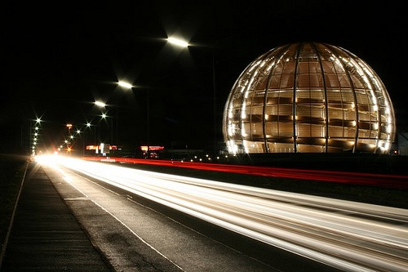
Our World Is Changing…

Slide 4
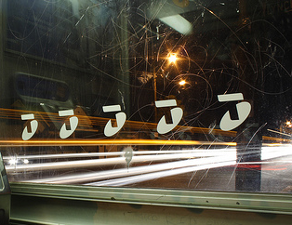
1955 – FIRST MICROWAVE OVEN
1958 – FIRST COMMERICAL JET AIRLINER
1961 – FIRST INDUSTRIAL ROBOT
1964 – FIRST UNMANNED AERIAL VEHICLES
1969 – FIRST AUTOMATED TELLER MACHINE
1970 – FIRST DIGITAL MUSIC
1973 – FIRST CELL PHONE
1979 – FIRST SONY WALKMAN
1984 – DNA FINGERPRINTING USED
1998 – FIRST MP3 PLAYER

Slide 5

Our World Has Changed
And We Are In Trouble
“How is it possible for a person to be an active member of an evangelical church for twenty or thirty years and still know next to nothing about the history and theology of the Christian religion, the methods and tools required for serious Bible study, and the skills and information necessary to preach and defend Christianity in a post-Christian, neopagan culture?”
J.P. Moreland, Love Your God With All Your Mind, p.188

Slide 6

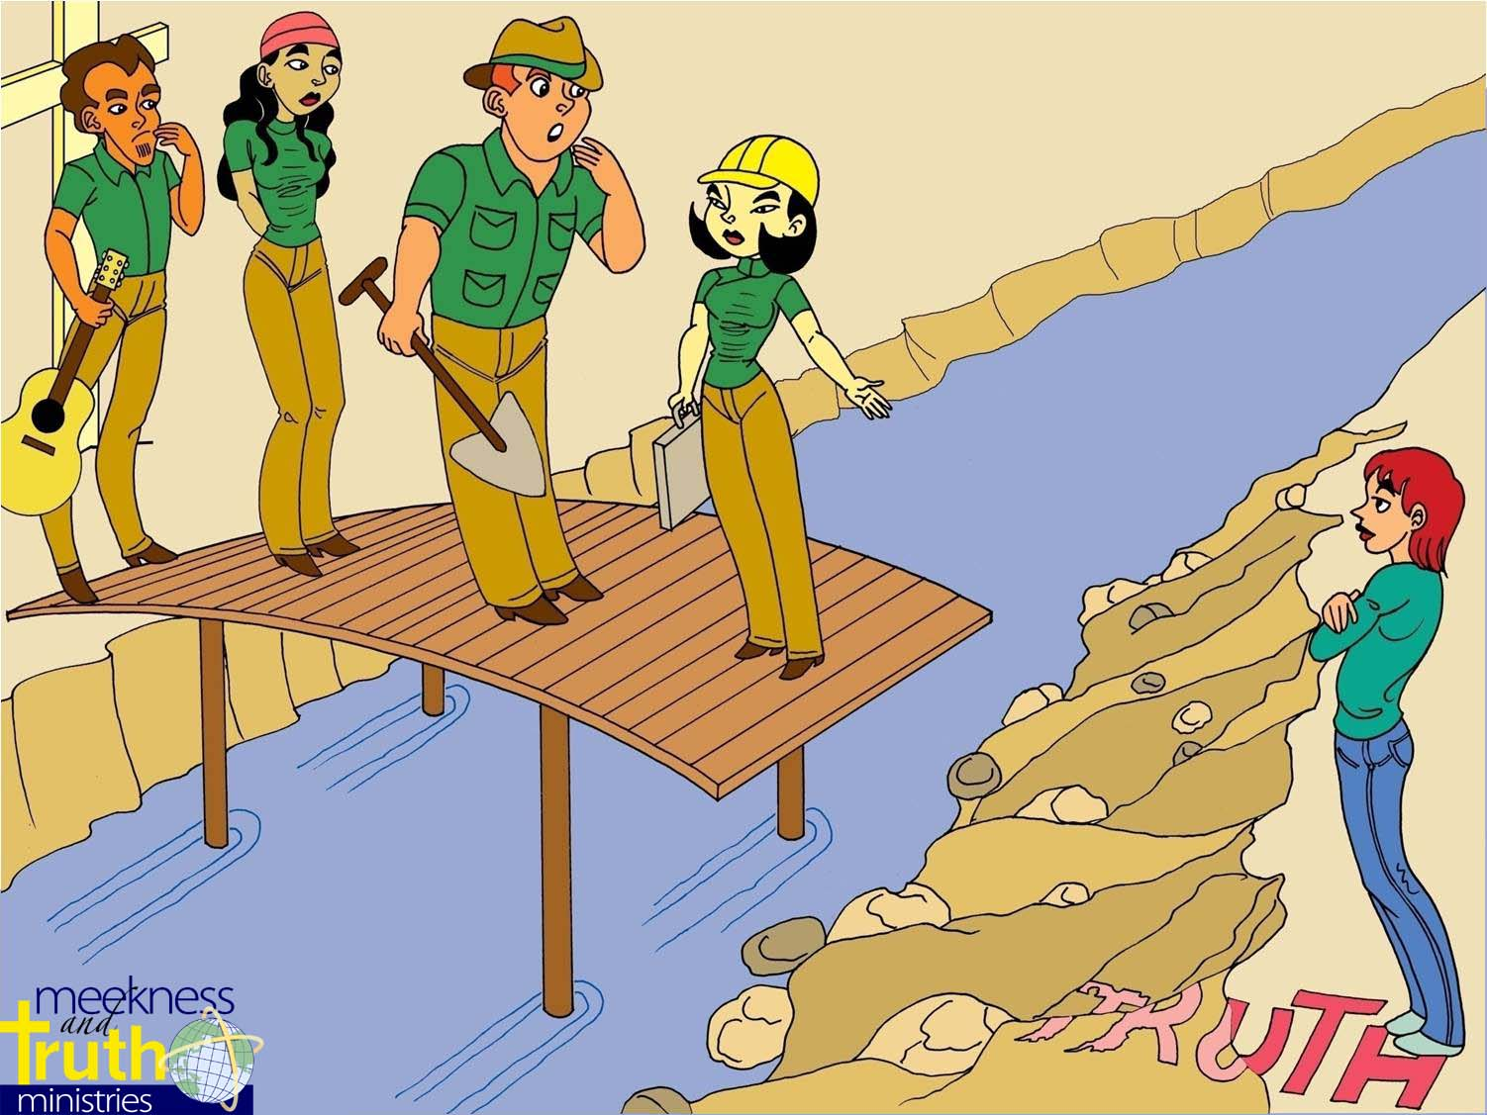

Our Evangelism Task Is More Daunting!
Conversational EVANGELISM
Notes:
6
The problem today is…because of the changing world we live in today there has been an erosion of truth, and because of that it is not so easy for people to build a bridge to the gospel.

Slide 7
There has been an erosion of truth!
Conversational EVANGELISM
Notes:
7
The problem today is…because of the changing world we live in today there has been an erosion of truth, and because of that it is not so easy for people to build a bridge to the gospel.

Slide 8

Obstacles to Evangelism Today
The World we Live In
It is not just a Western
Problem!
Signs of Trouble Have Surfaced Even In The East
Notes:
The obstacles we face in doing evangelism today are greater than ever before because,
We live in a world that is characterized by 3 things…(read slide)
You may think “I agree with you…that these are problems” but these are problems in the west right? We don’t have these kinds of problems here in the east right?

Slide 9
Signs of Trouble Have
Surfaced Even In The East
“Many students don't think that there is a standard of right and wrong. Rather, they believe that this is up to the individual. This means they do hold a standard of right and wrong themselves, but they feel that each person's standard of right and wrong differs from the other.”
“Personally, I feel stuck as to how to proceed on with the conversation. It's like saying that this food is nice for me but may not be nice for you. They relegate the standard of right and wrong to personal preference.”
- Former Student, East Asia School of Theology
Notes:
One of Dave’s former students is a college director of a church here in Singapore. They were witnessing on campus to one of the students, and they ran into some problems. Listen to what she said…

Slide 10
Signs of Trouble Have
Surfaced Even In The East
“I find that I'm shaken. Not in terms of my faith but in terms of how to answer such questions.”
- Former Student, East Asia School of Theology
Notes:
And then she said something that took me by surprise. Shed said that…(read slide)
The problem is if these are problems we are facing on our college campus in Singapore, what is going to happen when these same problems surface in 5-10 years in the church?
Illustration: Conversation with ex-president of Navigators…he agreed the churches are going to inherit these problems if they are not dealt with today.

Slide 11
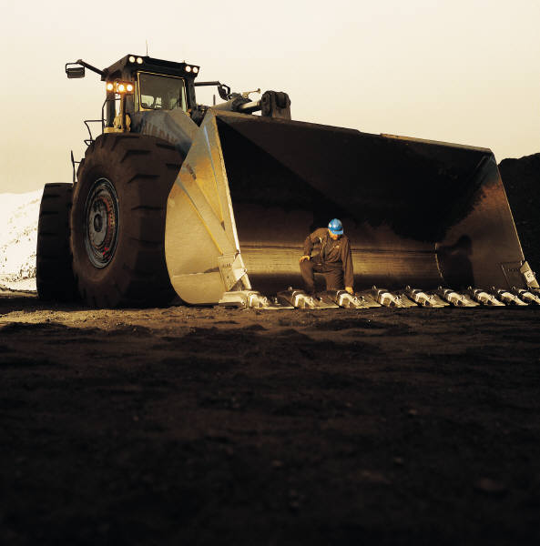
What Has Gone Wrong?
“When the foundations are being destroyed,
what can the righteous do.”
Psalm 11:3 (N.I.V.)

Slide 12
A World View Shift
“…a major cause of our current crisis consists of a world view shift from a Judeo-Christian understanding of reality to a post-Christian one.”
- J. P. Moreland, Love Your God with All Your Mind, p.21
Notes:
12
J P Moreland in his book Love Your God with All Your Mind says it this way… (read slide)
We now live in a post-modern world. And because of that this is creating problems for us in the whole area of evangelism.

Slide 13
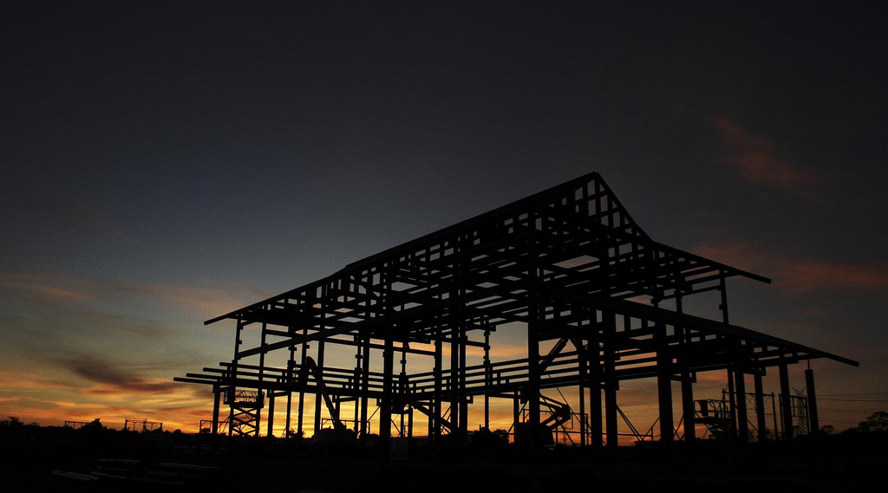
Our world has changed and has made
our evangelism task more daunting.
    Examples in the West
    B. Understanding the Post-Modern Period
    * Two Main Characteristics:
    1. Pluralism
    2. Post-Modernism
Notes:
13

Slide 14

Implications of postmodern thought that affect receptivity to the gospel:
    They believe persuasion is to be prohibited.
    They believe that to be exclusivistic is to be arrogant.

Slide 15
Implications of postmodern thought that affect receptivity to the gospel:
  They believe that our belief that Jesus
  is the way, the truth, and the life is just
  one of the narratives among other
  narratives in the world that are
  equally as valid.

Slide 16


Changing Beliefs - Pluralism
Historical Development of Western World Views
1st Century 17th Century 19th Century 19th-20th Century 20th Century Late 21st Century
Pre-Modern
Modern
Post-Modern
THEISM
ATHEISM
PLURALISM
Theism Deism Naturalism Nihilism Existentialism Fill in the blank
GOD
GOD
GOD
Post-Modernism Weak Theism
New Age: Pantheism, Monism
Bottom line: “What works for you.”
COSMOS
COSMOS
COSMOS
SOCIETY

Slide 17

Key Question
How can we talk to people in a way that creates greater interest in hearing our gospel in such a challenging world?
Answer:
We need to better understand the times or culture in which we live.
Notes:
So the question is: How can we do evangelism in this kind of world!?

Slide 18

Understanding the Times We Live In!
We need to be like the men of Issachar and understand the times in which we live and therefore know what we should do.
See I Chronicles 12:32
Notes:
It seems to me that we need to be…

Slide 19

If we understand the times we live in we will repackage our approach in evangelism

Slide 20
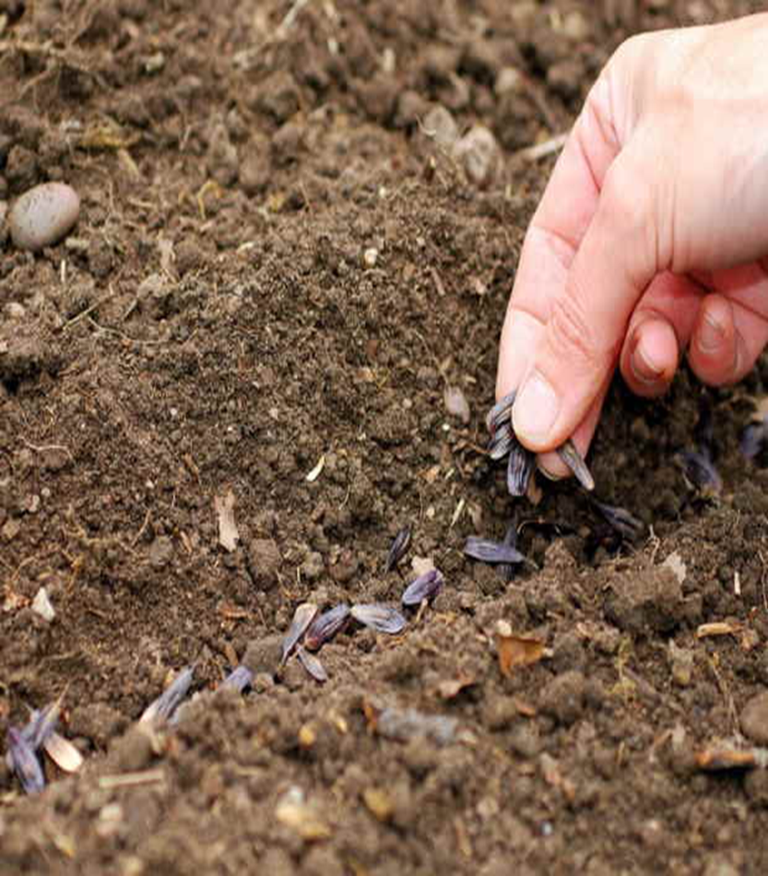

Defining Pre-Evangelism
If evangelism is planting seeds of the Gospel, pre-evangelism is tilling the soil of their mind and heart helping them to be more willing to hear the truth.
But pre-evangelism also involves helping to change the nature of the soil! Our job is to help people to cultivate good soil in their lives so that our seeds can be more fruitful (Mark 4:8; Matt. 13:23).

Slide 21

The Importance of
Transforming the Soil
Scriptural Basis: The Parable of the Sower Matt. 13:3-9, 19-23
In Matt. 13:23 Jesus tells us what happens if the seed gets into “good soil.”
“But the one who received the seed that fell on good soil is the man who hears the word and understands it. He produces a crop, yielding a hundred, sixty or thirty times what was sown.” (N.I.V.)

Slide 22

What keeps nonbelievers from cultivating good soil in their lives?
Yet in the parable of the sower Jesus helps us understand what conditions make it difficult for the seeds to bear spiritual fruit (Matt. 13:3-9, 19-23).
1. A pre-occupations with one’s personal comfort and temporal things (cares of every day life and amassing riches. (20-22)

Slide 23
What keeps nonbelievers from cultivating good soil in their lives?
Conditions that make it difficult for the seeds to bear spiritual fruit (Matt. 13:3-9, 19-23).
1. A pre-occupations with one’s personal comfort and temporal things (cares of every day life and amassing riches (20-21).
2. Lack of understanding (19)

Slide 24
When they don’t understand the Word (Matt. 13:19)
19 When anyone hears the word of the kingdom and does not understand it, the evil one comes and snatches away what has been sown in his heart. This is what was sown along the path. (E.S.V.)
* But why don’t they understand?

Slide 25
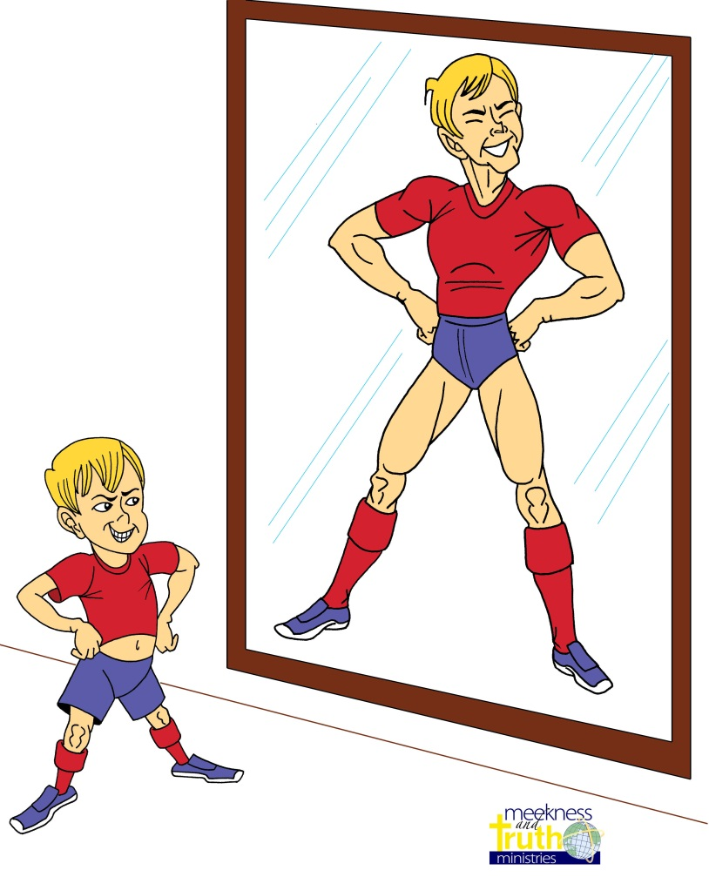
What keeps nonbelievers from cultivating good soil in their lives?
They Have a Distorted Perspective

Slide 26
What keeps nonbelievers from cultivating good soil in their lives?
Distorted perspective about themselves
Distorted perspective about God
Distorted perspective about Jesus Christ

Slide 27
What keeps nonbelievers from cultivating good soil in their lives?
Distorted Perspective
About themselves
They don’t see themselves as a sinner!
“The heart is deceitful above all things, and desperately sick; who can understand it?” Jer. 17:9 (ESV)

Slide 28
What keeps nonbelievers from cultivating good soil in their lives?
Distorted Perspectives
About God
They don’t understand God’s nature
* God’s holiness (Matt. 5:48; Js. 2:10)

Slide 29
What keeps nonbelievers from cultivating good soil in their lives?
Student’s Question
Why can’t God just let me into heaven?

Slide 30


Theological Truth:
We tend to overestimate our own righteousness and underestimate God’s holiness.
Notes:
30

Slide 31
Could I put a little sewage in your water?
If not do you see how something can seem so small but in reality still have a huge impact?
So is it possible our “sins” could cause a bigger barrier between us and God than we think?
Notes:
31

Slide 32
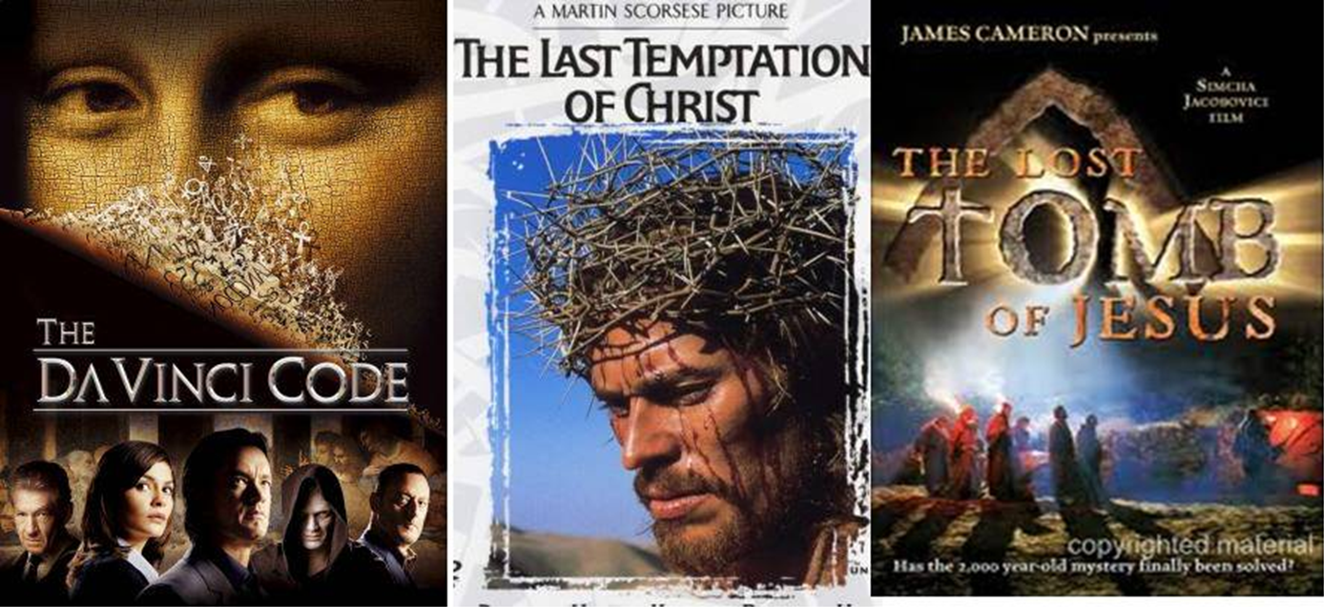
What keeps nonbelievers from cultivating good soil in their lives?
Distorted Perspective
About Jesus Christ

Slide 33
What keeps nonbelievers from cultivating good soil in their lives?
Distorted Perspective
About Jesus Christ
They don’t understand His Uniqueness

Slide 34

Christ’s Unique Life
“Buddha claimed to point to the way, Mohammed claimed to be a prophet of God, but Jesus Christ is the only major religious leader that ever claimed to be God, who fulfilled prophecy, lived a sinless life, and then died on the cross and rose from the dead.”
Dr. David Geisler
Notes:
The fact is that Christ’s claims…
For example here is a statement you can use to help others to see that Christian is not on the same level of other religious beliefs.
“Buddha claimed…”

Slide 35

The problems that arise because of distortions?
How can you proclaim the good news to the one who:
does not believe he/she is a sinner (morality is
relative) and hence does not need a Savior?
doesn’t believe in God and hence no judgment for him or her.
believes that all the ways eventually leads to one true God.
is very happy with himself/herself and really not interested in good news.
believes that he or she can measure up.

Slide 36
The Bottom Line About Pre-Evangelism
The more opportunity we have to share the Gospel, the greater likelihood that more people will come to know Christ.
The more pre-evangelism we do, the more opportunities we will have to share the gospel with others.
Therefore, the more pre-evangelism we do the greater likelihood that more people will come to Christ!
Notes:
Read slide

Slide 37
How Did Jesus and His
Disciples Cultivate “Good Soil”
By helping others to see the gaps in their beliefs!

Slide 38
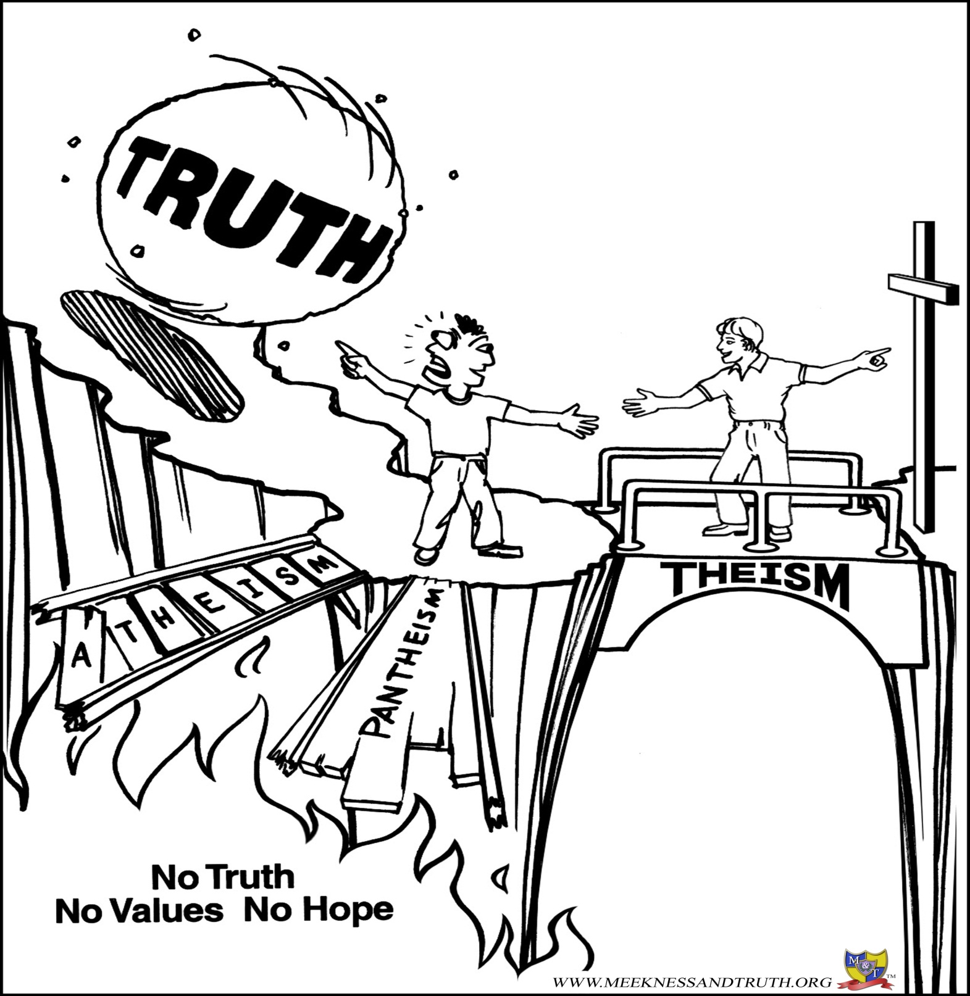
No Truth, No Values - No Hope
We need to teach others to face
the truth and respond appropriately!

Slide 39
Gaps in their Beliefs
Example: Idols in Acts 17:28-29
What are the two contradictory beliefs?
“For in Him we live and move and exist, as even some of your poets have said, ‘For we also are His offspring.’ Being then the offspring of God, we ought not to think that the Divine Nature is like gold or silver, an image formed by the art and thought of man.” (Acts 17:28-29 NASB)
You created these wooden gods.
These wooden gods created you.
Notes:
This is exactly the kind of thing we want to do in our conversations with our not-yet Christian friends.
For example in Acts 17:28-29 Paul pointed out two kinds of consistencies in the beliefs of the people of Athens. What were these two?
Paul says, “For in Him…
Answer:
On the one hand you are telling me you created these wooden gods, yet on the other hand you are telling me that these wooden gods created you. Which one of these is true?
And do you remember what their response was to the Apostle Paul? Some said in effect, “Paul you are crazy…,” some said, “we want to hear more,” and some actually responded in a positive way and trusted Christ. (Acts 17:32-34)
This means that the Holy Spirit can use an awareness of one’s discrepancies to help someone take one step closer to Jesus Christ.

Slide 40
How Did Jesus and His
Disciples Cultivate “Good Soil”
By helping others to see the gaps in their beliefs! (Acts 17:28-29
By how they allowed others to see these gaps (Matt. 19:16-22)

Slide 41
Jesus’ Approach in Matt: 19:16-22
“Now a man came up to Jesus and asked, ‘Teacher, what good thing must I do to get eternal life? Why do you ask me about what is good?’ Jesus replied. ‘There is only One who is good. If you want to enter life, obey the commandments.’
‘Which ones?’ the man inquired. Jesus replied, ‘Do not murder, do not commit adultery, do not steal, do not give false testimony, honor your father and mother,’ and ‘love your neighbor as yourself.’ ‘All of these I have kept,’ the young man said. ‘What do I still lack?’
Notes:
Jesus uses this approach too.
Aim is to show that this approach is used in the Bible.

Slide 42

Jesus’ Approach in Matt: 19:16-22
‘Jesus answered, ‘If you want to be perfect, go sell your possessions and give to the poor, and you will have treasures in heaven. Then come, follow me.’
‘When the young man heard this
He went away sad, because
he had great wealth.’”
Notes:
Jesus uses this approach too.
Aim is to show that this approach is used in the Bible.

Slide 43

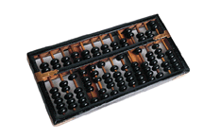
Inconsistent Beliefs
What were the two inconsistencies that Jesus wanted the rich young ruler to see?
A. I am a good person, I keep all of the commandments.
B. I care about financial wealth more than following Jesus.

Slide 44
How Did Jesus and His
Disciples Cultivate “Good Soil”
By helping others to see the gaps in their beliefs! (Acts 17:28-29
By how they allowed others to see these gaps in their beliefs (Matt. 19:16-22)
  * By helping them to surface the truth for themselves.

Slide 45

Allowing Others To Surface the Truth…
Interview
with UNC Greensboro student
Notes:
45
Instructions for the presenter:
Play the video clip. Instruct those you are teaching to listen carefully to the conversation. Point out that at certain points you will pause the video and ask them to tell you two things.
First, what did you hear them say?
Second, keeping the concepts of Conversational Evangelism in mind, what would you say to them in response?
Note:
The video clip includes markers to lets you know where to pause the video clip.
This video material is included in the Meekness CD in mp4 file format. It is called “Conversational Evangelism in Action (Short).” It also is included in our iPod videos that can be downloaded off of our web-site.
Note:
This video clip is very helpful after you teach the first two concepts (Hearing and Illuminating). It helps people to get a handle on how to use conversational evangelism in real life situations and also gives them practice on becoming a better listener.

Slide 46
How Did Jesus and His
Disciples Cultivate “Good Soil”
By helping others see the gaps in their beliefs! (Acts. 17:28-29)
By allowing others to surface the truth for themselves. (Matt. 19:16-22)
By creating in them a desire to hear more! (Jn. 4:10; Acts 17:32)

Slide 47
Hook Their Interest…
“Jesus answered her, "If you knew the gift of God and who it is that asks you for a drink, you would have asked him and he would have given you living water.”
Jn. 4: 10 N.I.V.

Slide 48



REMEMBER THE THREE D’S
Is it according to
the Three D’s of Asking Questions?
Doubt
Defensiveness
Desire
Conversational EVANGELISM
Notes:
We also want to ask questions with three objectives in mind in asking questions:
We want to ask questions that surface….
We call this the Three D’s of Asking Questions:
Doubt, Defensiveness, and Desire

Slide 49
Learning how to cultivate…
Learning how to cultivate good soil in today’s world can be helpful, in our witness to others, but there is also a prerequisite for pre-evangelism?
A Heart For God and the Lost!

Slide 50
The necessity of pre-evangelism for fruitful witnessing today
By Dr. David Geisler
Notes:
50
Training Description
- introduce a new paradigm to evangelism
give you the overall concept and some ideas of how to incorporate this
new paradigm into your evangelism, in this first part of the training
- in the second part of the training, you will master the skills that will
create opportunities for pre-evangelism conversations that could lead to
the presentation of the gospel.
Learning Outcomes
- that you will become more effective in evangelism as a result of
incorporating pre-evangelism conversation into your daily witness
- that the first part of these two days of training will result in you
acquiring the skills necessary for pre-evangelism conversation at the
second level of training
Teaching Style
- lectures, trainee participation

