Slide 1
ILLUMINATING
Dr. David Geisler

Slide 2
The Vital Role of The Holy Spirit in Evangelism
Conversational EVANGELISM
Notes:
2
“Now before we get into this ‘pre-evangelism’ model, it is critical that we explain the vital the important role of the Holy Spirit in the evangelism process. The Holy Spirit helps to empower us to make a difference in people’s lives.

Slide 3
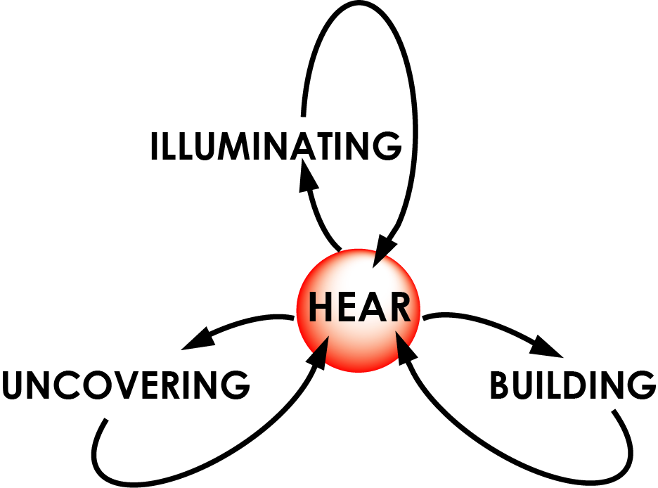
4 Types of Conversations We Want to Have with Non-believers
Notes:
The Conversation Evangelism model consists of four different kinds of conversations we want to have with our pre-believing friends.
They are: a Hearing Conversation, an illuminating conversation, an uncovering conversation, and a building conversation.
Understanding how to have each of these four kinds of conversations with our pre-believing friends is important if we are going to help them take steps towards Christ, especially in the kind of world we live in today.

Slide 4
4 Types of Roles You Need to Play in Your Friend’s Life
Musician
Artist
Archeologist
Builder
Notes:
4
These four kinds of conversations correspond to four roles you and I need to play in our pre-believing friends’ lives,
A musician
An artist
An archeologist
A builder

Slide 5
Listen To What They are Saying!
Hear
Illuminate
Uncover
Build
Notes:
5
First, we want to focus on hearing.
Once we hear what our pre-believing friends believe and have a better idea of where they are coming from, it will help us to know the kind of questions to ask them in order to help them think more clearly about their beliefs.
But it all starts with the idea of listening to them and really hearing what they are saying to us first.

Slide 6
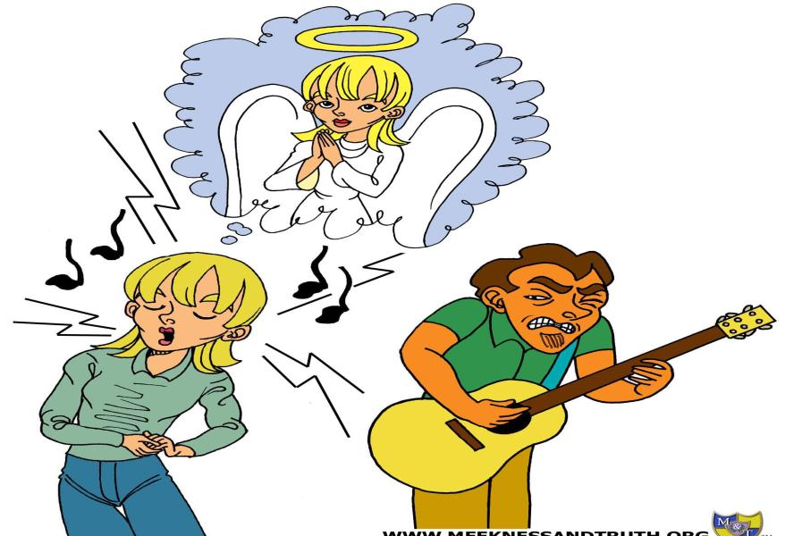
Hear the Sour Notes People are Singing to Us!
Conversational EVANGELISM

Slide 7
What You Might Hear
Types of “sour notes” or inconsistencies you might hear:
Belief vs. Heart Longing (Eccl. 3:11)
Belief vs. Behavior (Gal 2:14-16)
Belief vs. Belief (Acts 17:22-30)
Illogical Belief (2 Cor. 1:18)

Slide 8
Illuminate The Discrepancies!
Hear
Illuminate
Uncover
Build
Conversational EVANGELISM
Notes:
8
Summarize:
Now the second kind of conversation we want to have with our pre-believing friends is Illuminating conversations.
This is where we want to turn the light on and illuminate and help our friends to see what we see. Yet we want to do it in a way that allows them to surface the truth for themselves rather than us telling them what to believe.

Slide 9
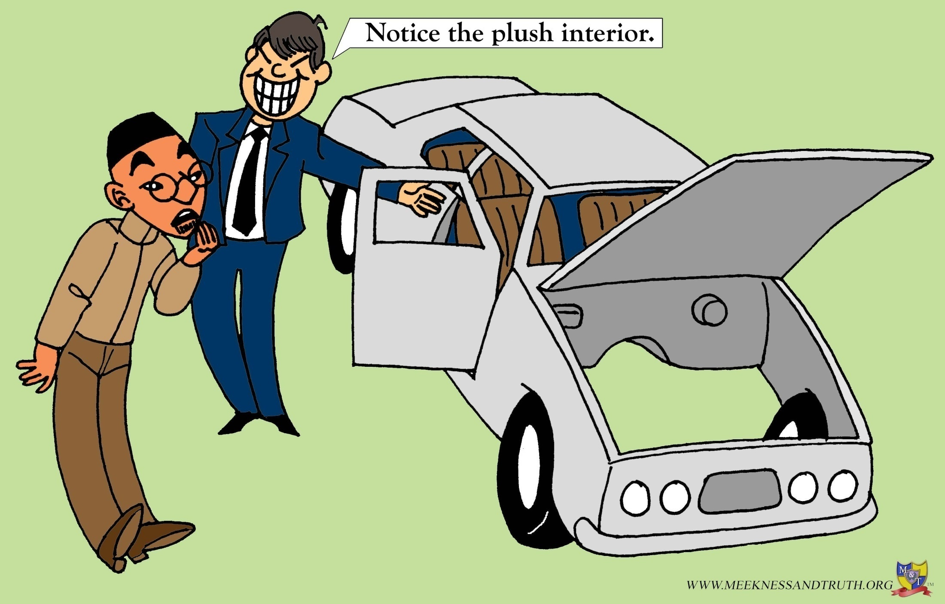
What question should be asked?
Conversational EVANGELISM
Notes:
9
ASK the trainees…
What question should this person ask the car salesman?
Notice that the car salesman is trying to direct his attention at the plush interior
What is the sour note to be identified in this situation?
Answer: Where is the engine?
In a similar way, we want to ask our pre-believing friends questions in a way that helps them to identify the sour notes in their perspective.

Slide 10
4 Types of Roles You Need to Play in Your Friend’s Life
Archeologist
Artist
Builder
Musician
Notes:
10
These four kinds of conversations correspond to four roles you and I need to play in our pre-believing friends’ lives,
A musician
An artist
An archeologist
A builder

Slide 11
The Importance of Questions
Asking questions helps paint a picture to help them see themselves more clearly
Conversational EVANGELISM
Notes:
11
We want to paint a picture to help them see themselves clearly.
We do that by asking them questions.
When they answer our questions they are providing information that paints a clearer picture of who they are.
Like a mirror we help them see what they believe in or don’t believe in more clearly.

Slide 12
The Importance of Questions
Questions that uncover the meaning of certain unclear terms.
Questions that surface uncertainty and/or expose false belief systems or concepts.
Conversational EVANGELISM
Notes:
12
We want to paint a picture to help them see themselves clearly.
We do that by asking them questions.
When they answer our questions they are providing information that paints a clearer picture of who they are.
Like a mirror we help them see what they believe in or don’t believe in more clearly.

Slide 13
Questions that uncover the meaning of certain unclear terms
What do you mean by …?
All religions are basically the same
Good person
Died for us
Agnostic
Atheist
Jesus is God
Conversational EVANGELISM
Notes:
13
Now if you forget everything I say so far, I want you to remember this first important point; Learn to begin to ask in your conversation with your pre- believing friends, “What do you mean by…?
This is important because we cannot assume that they have the same meaning or understanding of key terms that we use.
For example, if someone says to you Jesus is my savior, what question do you want to ask them?
Answer: What do you mean by Savior?
What if someone says I am a pretty good person so I am going to get into heaven. What question do you want to ask them?
Answer: What do you mean by good?
If some says I believe that Jesus died for us, what question do you want to ask them.
Answer: What do you mean by “Died for us.” The reason why this is important is that he or she may have a different understand of what “Died for us” really means. For example some may think that Jesus died only as a moral example to show us how to live.
Now is embracing this truth really what being a Christian is all about?
Answer: No, because the bible teaches us in Romans 5:8 that God demonstrated his own love for us in that while we were yet sinners, Christ died for us.
In the Greek the preposition (For) in Romans 5:8 means that He died in our place and for our benefit. He was more than just a moral example.
But if you don’t clarify the meaning of this definition, your friends might not understand this.
In using this approach in asking for clarification of terms, a helpful tip to keep in mind is to remember to take advantage of your ignorance about what they believe as you ask questions for clarification!

Slide 14
The Importance of Questions
Questions that help clarify the meaning of certain unclear terms.
Questions that surface uncertainty and/or expose false belief systems or concepts.
Conversational EVANGELISM
Notes:
14
We want to paint a picture to help them see themselves clearly.
We do that by asking them questions.
When they answer our questions they are providing information that paints a clearer picture of who they are.
Like a mirror we help them see what they believe in or don’t believe in more clearly.

Slide 15
Questions that Surface Uncertainty and/or Expose False Belief Systems or Concepts
How are we suppose to do this?
Begin with asking probing questions that surface the uncertainty in their beliefs
Conversational EVANGELISM
Notes:
15
We want to paint a picture to help them see themselves clearly.
We do that by asking them questions.
When they answer our questions they are providing information that paints a clearer picture of who they are.
Like a mirror we help them see what they believe in or don’t believe in more clearly.

Slide 16
Introductory Questions to Explore the Uncertainties of Their Beliefs
Do you really think it really matters what we believe?
Do you think that all religious beliefs basically teach the same thing?
Do you think it is possible that you and I were put here on this earth for some kind of purpose? If so what do you think that was?
Notes:
16
Here are some examples of the kinds of questions that you may use to help them to explore the uncertainty of their own perspective.
List questions 1-3 (read slide)
Can you think of questions that you might use in your conversation with those you want to reach that might help them to explore the uncertainty in their own perspective?
(Ask others for suggestions)

Slide 17
Follow-up Questions that Can Expose False Beliefs or Concepts
How is it possible ...
... for all religions to be the same when some of them contradict each other’s key beliefs?
... for there to be meaning and purpose in our lives and at the same time believe that there is no God?
Notes:
17
17
Then once you begin to ask your pre-believing friends questions that surface their uncertainties, you can follow those questions with more penetrating questions that expose false beliefs or concepts.
Such as how is it possible…(read slide)

Slide 18
Asking Thought Provoking Questions!
If you were coming to the end of your life, and you met Jesus and other great religious leaders, and each suggested a different path, who’s advice should you take?
Wouldn’t you take the advice of someone who’s been to the other side and come back to tell us about it?
Notes:
18
Questions to ask someone who may consider all religious leaders to have equal validity.

Slide 19
Follow-up Questions That Can Expose False Beliefs or Concepts
Other helpful questions...
… Have you come to any conclusions about Jesus Christ?
... How do you fit Jesus into your religious beliefs?
Notes:
19
19
Then once you begin to ask your pre-believing friends questions that surface their uncertainties, you can follow those questions with more penetrating questions that expose false beliefs or concepts.
Such as how is it possible…(read slide)

Slide 20
Charlotte Survey Questions www.conversationalanswers.com
Question #1
If you could travel back in time to any place, or to meet any person, who would you want to meet or where would you want to go and why?”
Question #2
Out of all the problems that we are facing in our world today, what do you consider is our biggest problem and how do you think we can solve this problem?
Question #3
Do you think it is possible that you and I were put here on this earth for some kind of purpose? If so, what do you think that was? If not, why do you think so?
Notes:
20
20
Then once you begin to ask your pre-believing friends questions that surface their uncertainties, you can follow those questions with more penetrating questions that expose false beliefs or concepts.
Such as how is it possible…(read slide)

Slide 21
Charlotte Survey Questions www.conversationalanswers.com
Question #4
We live in a world that that tends to believe, now more than ever, that all religions are equal and no one religion is better than another. In your opinion does it matter what someone believes? If not, why not, if so, why so?
Question #5
Religions have different beliefs about the afterlife but many seem to indicate that it is possible we could be in a better place, if we do the right things in this life.
Part 1 - What do you personally believe about the afterlife and what do you think we need to do in this life in order to get to this better place in the next life?
Part 2 - If there is no life after this life is over…where do you think we came from and why do we seem to be unable to avoid believing in things like, truth, love, beauty, goodness and etc.?
Notes:
21
21
Then once you begin to ask your pre-believing friends questions that surface their uncertainties, you can follow those questions with more penetrating questions that expose false beliefs or concepts.
Such as how is it possible…(read slide)

Slide 22
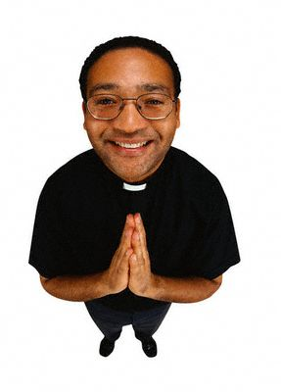
Lets Try It!
Some non-Christians who believe in God say
they are getting to heaven by
Being mostly good
Performing more good deeds than bad deeds
High standard
Following the Ten Commandments
Treating others well
Trying their best
Being sorry for the bad things
Being humble
What questions might you want to ask?
Notes:
22
Now let’s practice this approach using questions.
Here is a list of ways that others believe they are getting to heaven.
By being…
Now what question might you want to ask these people to help them to see that there is something wrong with their perspective.
Answer:
(Let them give you a bunch of questions that one might use)
These are all good questions. Here is a common response you can use that not only will speak to their mind, but more important will penetrate their heart.

Slide 23
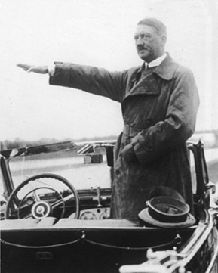
Exploring Their Beliefs
Example Follow-up Question:
“Do you think Hitler will be in Heaven?”
“If Hitler will not be in Heaven, what is the standard by which we will all be judged?”
(Matthew 5:48; James 2:10)
12 million murdered
Notes:
23
Answer:
“Do you think Hitler will be in Heaven?”
ASK: Now why do you think this is a good question to ask them?
ASK: How do you think they will probably answer this question if they are not Mormons? Won’t that say no Hitler will not be in heaven.
So then they have a standard that Hitler doesn’t measure up to, but other people do.
ASK: What is a followup question you might to ask them?
Answer:
“What is the standard that Hitler doesn’t measure up to, but other people do?
“Because my Bible teaches me in Matthew 5:48 that we are to be perfect like our heavenly father is perfect. Furthermore James 2:10 says that if we stumble in one point of the law we are guilty of the whole law.”
Do you see now how asking a simple question could cause someone to reconsider whether their perspective is adequate to build their lives around?

Slide 24
The Right Questions Can Help Them Better Face The Truth!
Conversational EVANGELISM
Notes:
24

Slide 25
Conversational Evangelism in Action (Short)
Interview
with college students
Notes:
25
Instructions for the presenter:
Play the video clip. Instruct those you are teaching to listen carefully to the conversation. Point out that at certain points you will pause the video and ask them to tell you two things.
First, what did you hear them say?
Second, keeping the concepts of Conversational Evangelism in mind, what would you say to them in response?
Note:
The video clip includes markers to lets you know where to pause the video clip.
This video material is included in the Meekness CD in mp4 file format. It is called “Conversational Evangelism in Action (Short).” It also is included in our iPod videos that can be downloaded off of our web-site.
Note:
This video clip is very helpful after you teach the first two concepts (Hearing and Illuminating). It helps people to get a handle on how to use conversational evangelism in real life situations and also gives them practice on becoming a better listener.

Slide 26
Why Asking Questions is So Helpful?
“A person can close his ears to facts he does not want to hear, but if a pointed question causes him to form the answer in his own mind, he cannot escape the conclusion—because it’s a conclusion that he reached himself.”
David Reed Baker, Jehovah’s Witnesses Answered Verse by Verse, (Grand Rapids: Baker, 1986) p. 113
Notes:
26

Slide 27
How do I know if I am asking the right kind of questions in the right way?
Is it according to
the Three D’s of Asking Questions?
Doubt
Defensiveness
Desire
Conversational EVANGELISM
Notes:
We also want to ask questions with three objectives in mind in asking questions:
We want to ask questions that surface….
We call this the Three D’s of Asking Questions:
Doubt, Defensiveness, and Desire

Slide 28
How do I know if I am asking the right kind of questions in the right way?
Ask “Am I asking questions in a way that surfaces their doubt (uncertainty) about their own perspective, while at the same time minimizes their defensiveness, and yet creates a desire (curiosity) to want to hear more?”
Conversational EVANGELISM
Notes:
We also want to ask questions with three objectives in mind in asking questions:
We want to ask questions that surface….
We call this the Three D’s of Asking Questions:
Doubt, Defensiveness, and Desire

Slide 29
How do I minimize someone’s defensiveness?
Ask “Am I asking questions in a way that surfaces their doubt (uncertainty) about their own perspective, while at the same time minimizes their defensiveness, and yet creates a desire (curiosity) to want to hear more?”
Conversational EVANGELISM
Notes:
We also want to ask questions with three objectives in mind in asking questions:
We want to ask questions that surface….
We call this the Three D’s of Asking Questions:
Doubt, Defensiveness, and Desire

Slide 30
The Joy of Self-Discovery
Conversation With Guy
In Exercise Room
What church do you go to?
“I go to _______ catholic church … We believe in Mary!
What do you mean by…We believe in Mary?
We believe that Mary makes up what Jesus’ lacks!

Slide 31
The Joy of Self-Discovery
CONVERSATION WITH GUY
IN EXERCISE ROOM
But do you know what 1 Tim 2:5 says?
What do you think this verse teaches?
Certainly I can see how some Catholics could see Mary
as being a helpful person who could pray for them just
as some Baptist might consider it helpful if they got
Billy Graham to pray for them.
“But can Mary do anything to help you atone for your
sins in any way?”

Slide 32
How do I create a desire on their part to continue the conversation?
Doubt
Defensiveness
Desire
Conversational EVANGELISM
Notes:
We also want to ask questions with three objectives in mind in asking questions:
We want to ask questions that surface….
We call this the Three D’s of Asking Questions:
Doubt, Defensiveness, and Desire

Slide 33
How To Ask Questions
Highway Video clip
Who is Jesus Christ?
www.highwayvideo.com
Notice his skill in asking questions in a non-defensive way.
Notice how he is listening to what others say and asking follow-up questions based on what they say.

Slide 34
Good Follow-up Questions
Is there any reason to consider Him further?
Have you ever thought about it?
What have you come up with?
Do you think there is any reason to decide?
Do you think there is any reason to check it out further?
Does He mean anything to you?
Do you think there is any reason to decide?
Do you care?

Slide 35
4 Types of Conversations We Want to Have with Non-believers
Notes:
35
The Conversation Evangelism model consists of four different kinds of conversations we want to have with our pre-believing friends.
They are: a Hearing Conversation, an illuminating conversation, an uncovering conversation, and a building conversation.
Understanding how to have each of these four kinds of conversations with our pre-believing friends is important if we are going to help them take steps towards Christ, especially in the kind of world we live in today.

Slide 36
ILLUMINATING
Dr. David Geisler

